Slide 1
Machine Learning Project
Team members:
Rishika Rathore 17045084
Abhishek Kumar 16074002
BHANU PRAKASH 16074004

Slide 2
Problem Statement
The objective of this project is to early detect sepsis (6 hours ahead) utilizing physiological information. The sources of info are patients' data, including imperative signs, research center qualities and demographics. The output is the results whether the model predicts non-Sepsis patients or Sepsis patients six hours in front of clinical beginning time.

Slide 3
Dataset Details
For this study, we use clinical data of ICU patients from two separate hospital systems provided by the PhysioNet Computing in Cardiology Challenge 2019. The data for each patient are saved in a single pipe-delimited text file that has a fixed header. Each row of a patient file represents a single hour's worth for all the measurements within that ICU-hour stay. These measurements include vital signs, laboratory, and demographics values of 40 time-dependent variables. Nan indicates that the measurement is missing at this time interval. In total, we used over 40,336 patient files. After concatenating ICU-hour-stay entries from all the patients, we have about 1,552,229 lines of data in total.
According to the Challenge, labels in the dataset already take the goal of predicting Sepsis. The label for each hour of patient data is 1 (Sepsis onset positive) or 0 (Sepsis onset negative). Summarized from the labels, we have a very imbalanced dataset.
Click here to download the complete training database, consisting of two parts: training set A (20,336 subjects) and B (20,000 subjects).

Slide 4
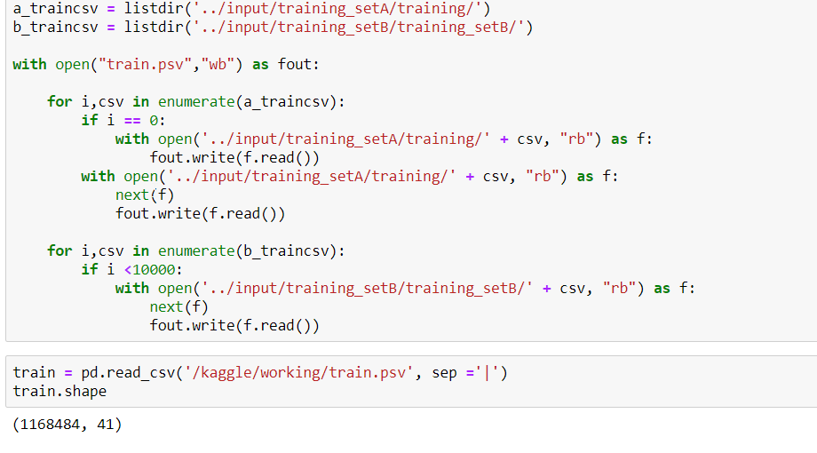
Data Study
The data is stored as two files named: “training_setA” and “training_setB”
Further there are excel files into these folder.
All these folders have been merged and a single pandas files has been obtained for further processing .
Also, files has been divided into Train,
Validation and Test Datatset.

Slide 5
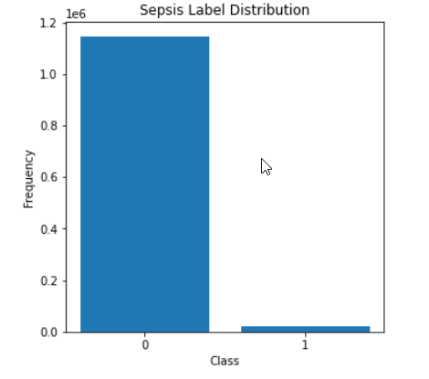
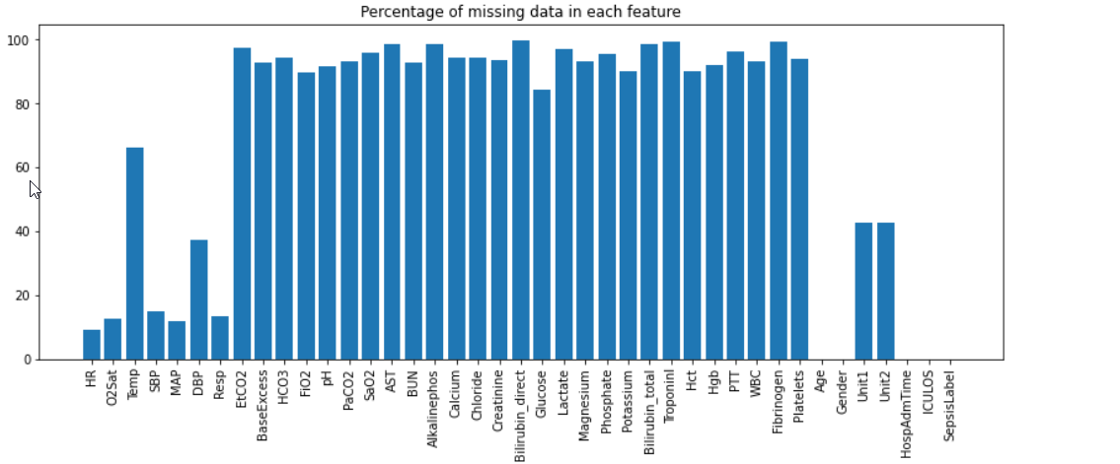
Data Visualizations and insights
Firstly it was checked how many values of each class is present , and it was concluded that the data is highly imbalanced . To handle that we will use average precision. Other methods include undersampling, oversampling etc
Next we checked the percentage of null values
in every column and dropped the columns which have
more than 90% NULL values
After that we obtained the correlation matrix and
plotted the heatmap to visualize.

Slide 6
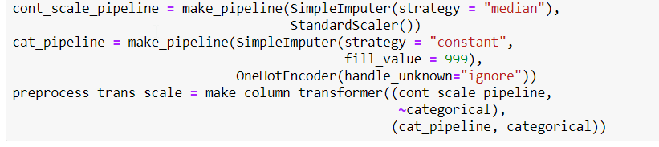
We have also plotted the box plot to visualize how the values are spread and what are the IQR.
The box plot helped us to decide what to replace NULL values with. We will replace NULL values with median for non-categorical values. And for categorical values we will replace NULL values by constant.
Next we trained the models on this data and obtained the baselone accuracies.

Slide 7
Feature Engineering
On analysis we realized that there are certain features that are of extreme importance to this classification task.
These features include
Heart Rate
Temperature
Age
O2Stat
SBP and DBP
Respiration Rate

Slide 8
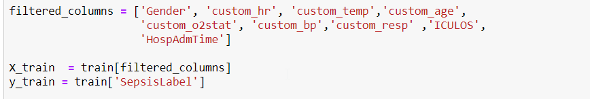
Finally filtered features
According to the CDC website heart rate, fever and BP are the most important signs of sepsis. So selecting the features on this basis,we finally included following features:

Slide 9
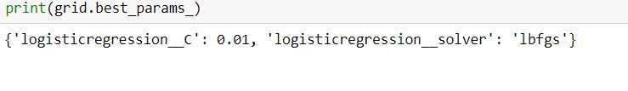
Training and application of Grid Search
Next model was trained on various models and later on we also apploied gried search to get hyperparameter.
We realized that on application of Grid search that for Logistic Regression
Also Logistic Regression has performed the best amongst all the models.

Slide 10
